Slide 1
IBM AICTE PROJECT
Interview Ready AGENT
Presented By: JOVITA JOY
Student name :JOVITA OY
College Name & Department :ADI SHANKARA INSTITUTE OF ENGINEERING AND TECHNOLOGY,KALADY-CSE(AI)

Slide 2
OUTLINE
Problem Statement
Technology used
IBM Cloud services used
Wow factor
End users
Quick Start Questions & Setting up
Deployment & Preview
API Reference After Deployment
Resources List
Results
Conclusion
Git-hub Link
Future scope
IBM Certifications

Slide 3
PROBLEM STATEMENT
Job seekers, especially fresh graduates and early-career professionals, often struggle to prepare effectively for job interviews due to a lack of personalized guidance, access to role-specific questions, and feedback on their answers. Traditional preparation methods are either generic, time-consuming, or require costly coaching. Additionally, the rapidly changing expectations of recruiters make it difficult for candidates to stay updated with relevant technical and behavioral questions.
To address this, the goal is to design and build an AI-powered Interview Trainer Agent named 'Interview Ready' using IBM Granite and Retrieval-Augmented Generation (RAG). The agent should help users by generating customized interview questions, model answers, and tips based on their resume, skills, and job role.
Proposed Solution :
'Interview Ready' is an AI-based interview preparation assistant that uses IBM Granite and RAG to deliver customized, role-specific interview questions, model answers, and improvement suggestions to job seekers. It features a user input interface, resume/role analyzer, a RAG-based question generation engine, optional answer evaluation, and a user-friendly frontend interface. It generates technical, behavioral, and situational questions, provides sample answers, and gives feedback to improve user readiness and confidence in interviews.

Slide 4
TECHNOLOGY USED
IBM Cloud Lite
IBM Watsonx Prompt Lab
IBM Granite Foundation Models
RAG (Retrieval-Augmented Generation) pipeline

Slide 5
IBM CLOUD SERVICES USED
1. IBM Watsonx.ai Studio
Used to build, test, and refine prompts with Granite Foundation Models.
Provides the environment for prompt lab, RAG workflows, and tuning.
2. IBM Granite Foundation Models
The core LLM (e.g., granite-13b-instruct-v2) used for:
Generating technical and HR interview questions
Producing model answers and improvement tips
3. IBM Cloud Object Storage
Stores user-uploaded resumes or training data.
Supports integration with NLP parsers for resume analysis.
4. IBM Cloud Functions
Handles backend logic serverlessly (e.g., parsing resumes, triggering prompts, handling APIs).
Allows scaling of AI operations without managing infrastructure.
5. IBM Watson Machine Learning (Optional - for Model Management)
For deploying additional custom NLP or classification models (e.g., scoring user answers).

Slide 6
WOW FACTORS
1. Personalized Interview Prep
Generates custom questions based on the user’s resume, skills, and job role.
Unlike generic interview apps, it provides tailored content that evolves with the user’s input.
2. Model Answers + Improvement Tips
For every question, it provides a well-structured model answer and practical tips for refining user responses—mimicking the role of a real interview coach.
3. RAG + IBM Granite Integration
Uses Retrieval-Augmented Generation (RAG) with Granite LLMs, combining trusted knowledge sources with intelligent question formulation.
Delivers context-aware, role-specific interview simulation.
4. Smart Resume Analysis
Automatically parses resume input to extract job role, skills, projects, and suggests matching question sets accordingly.
Eliminates the need for manual filtering or role selection.
5. Seamless Cloud Deployment
Built with IBM Cloud Functions and Watsonx, enabling low-cost, serverless, scalable deployment.
Easily integratable into websites, apps, or career portals.

Slide 7
END USERS
1. Students & Fresh Graduates
Those preparing for campus placements or entry-level jobs.
Can practice domain-specific and behavioral questions.
2. Job Seekers & Career Switchers
Professionals looking to change industries or roles.
Get interview content tailored to their new career path.
3. Training & Placement Officers
Can integrate Interview Ready into campus career services.
Helps students self-train and improve placement readiness.
4. Recruiters & Hiring Managers (Optional Use Case)
May use the tool to pre-screen or assess candidate readiness.
5. Online Career Coaching Platforms
Edtech or bootcamp companies can embed Interview Ready as a self-assessment or prep tool.

Slide 8
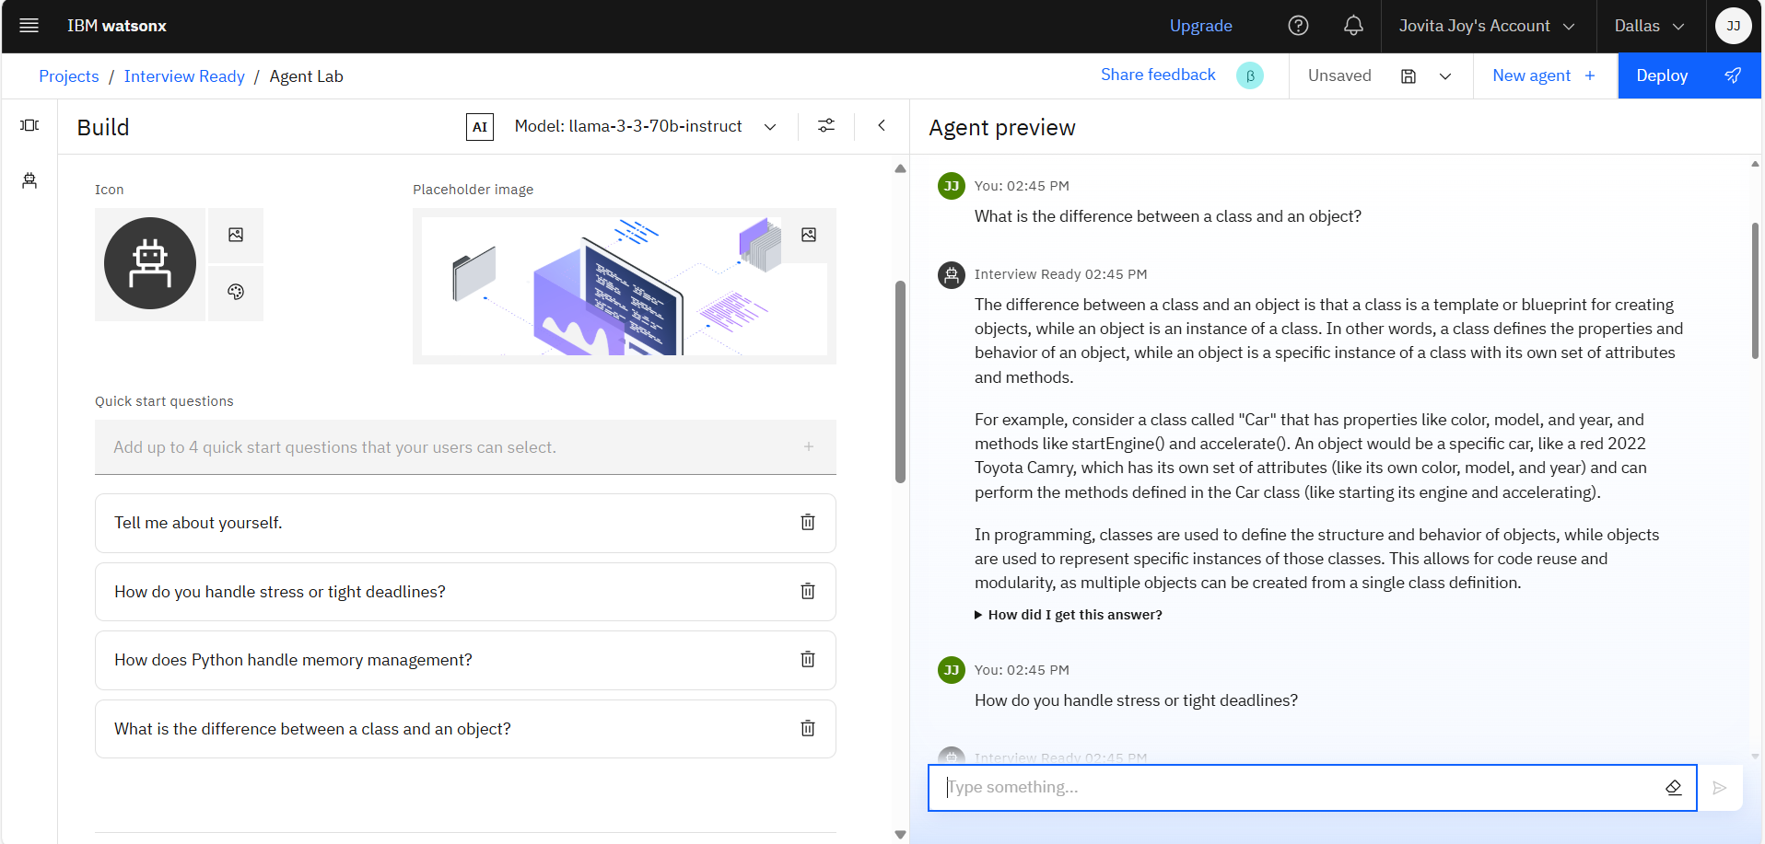
QUICK START QUESTIONS PREVIEW & SETTING UP

Slide 9
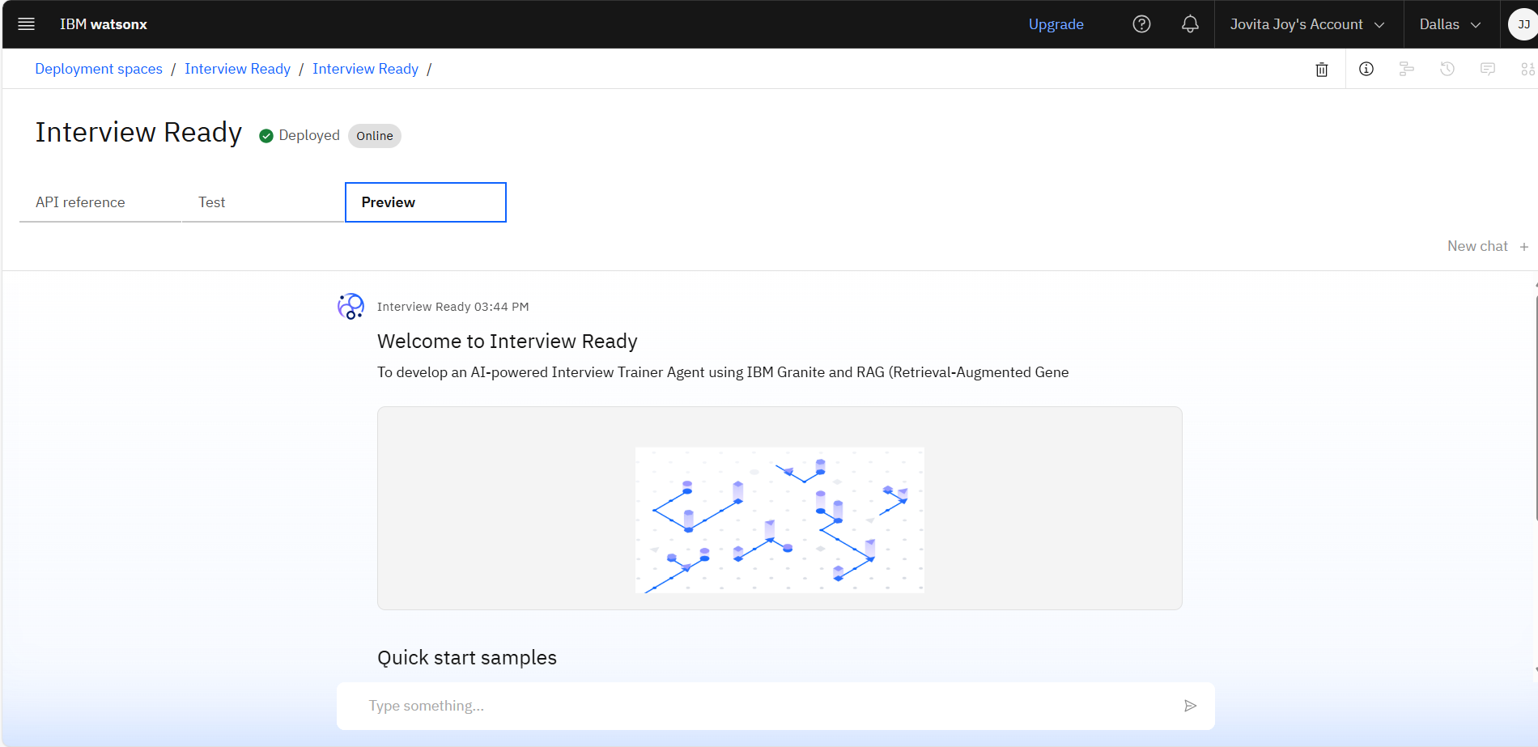
DEPLOYMENT & PREVIEW

Slide 10
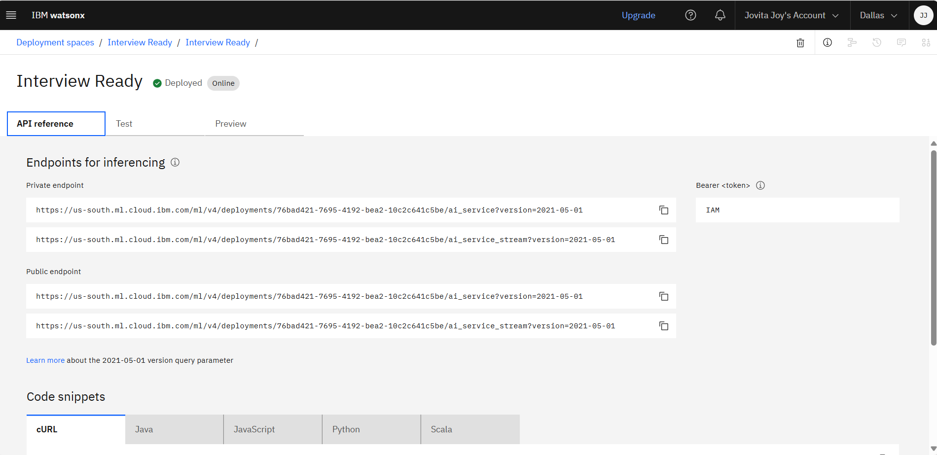
API REFERENCE AFTER DEPLOYMENT

Slide 11
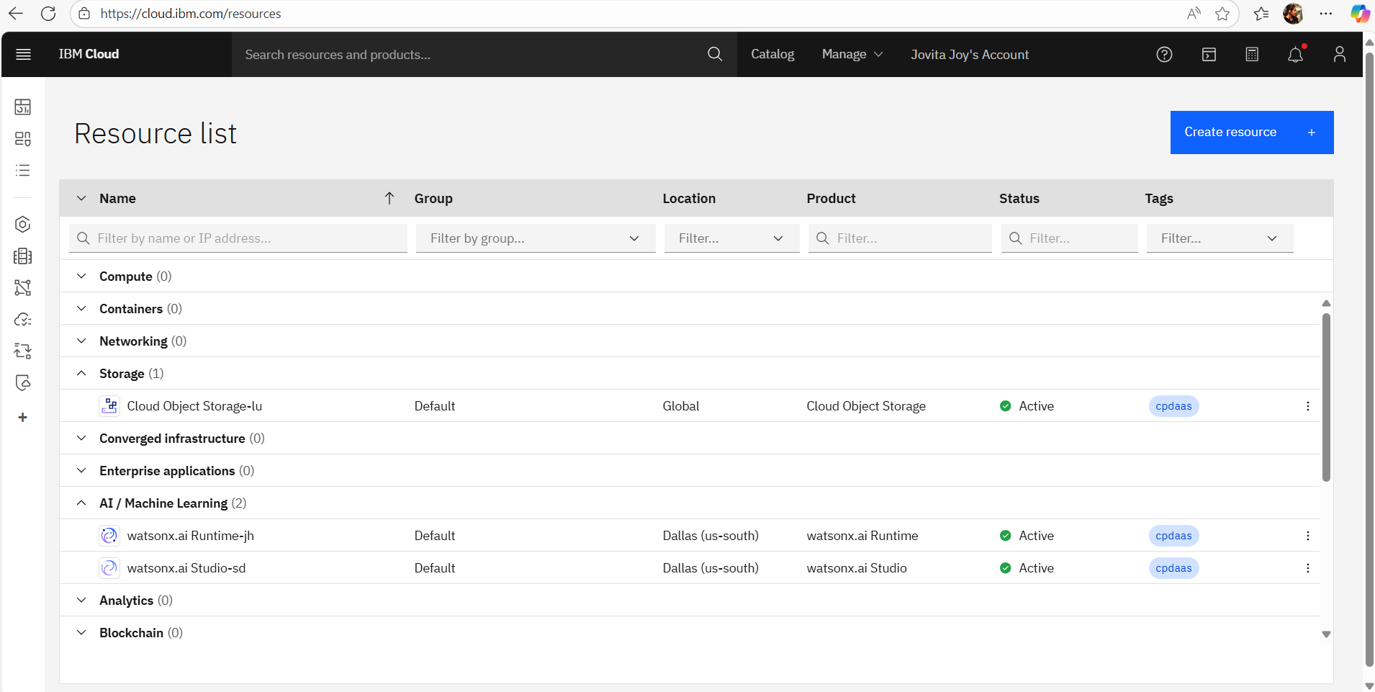
RESOURCES LIST

Slide 12
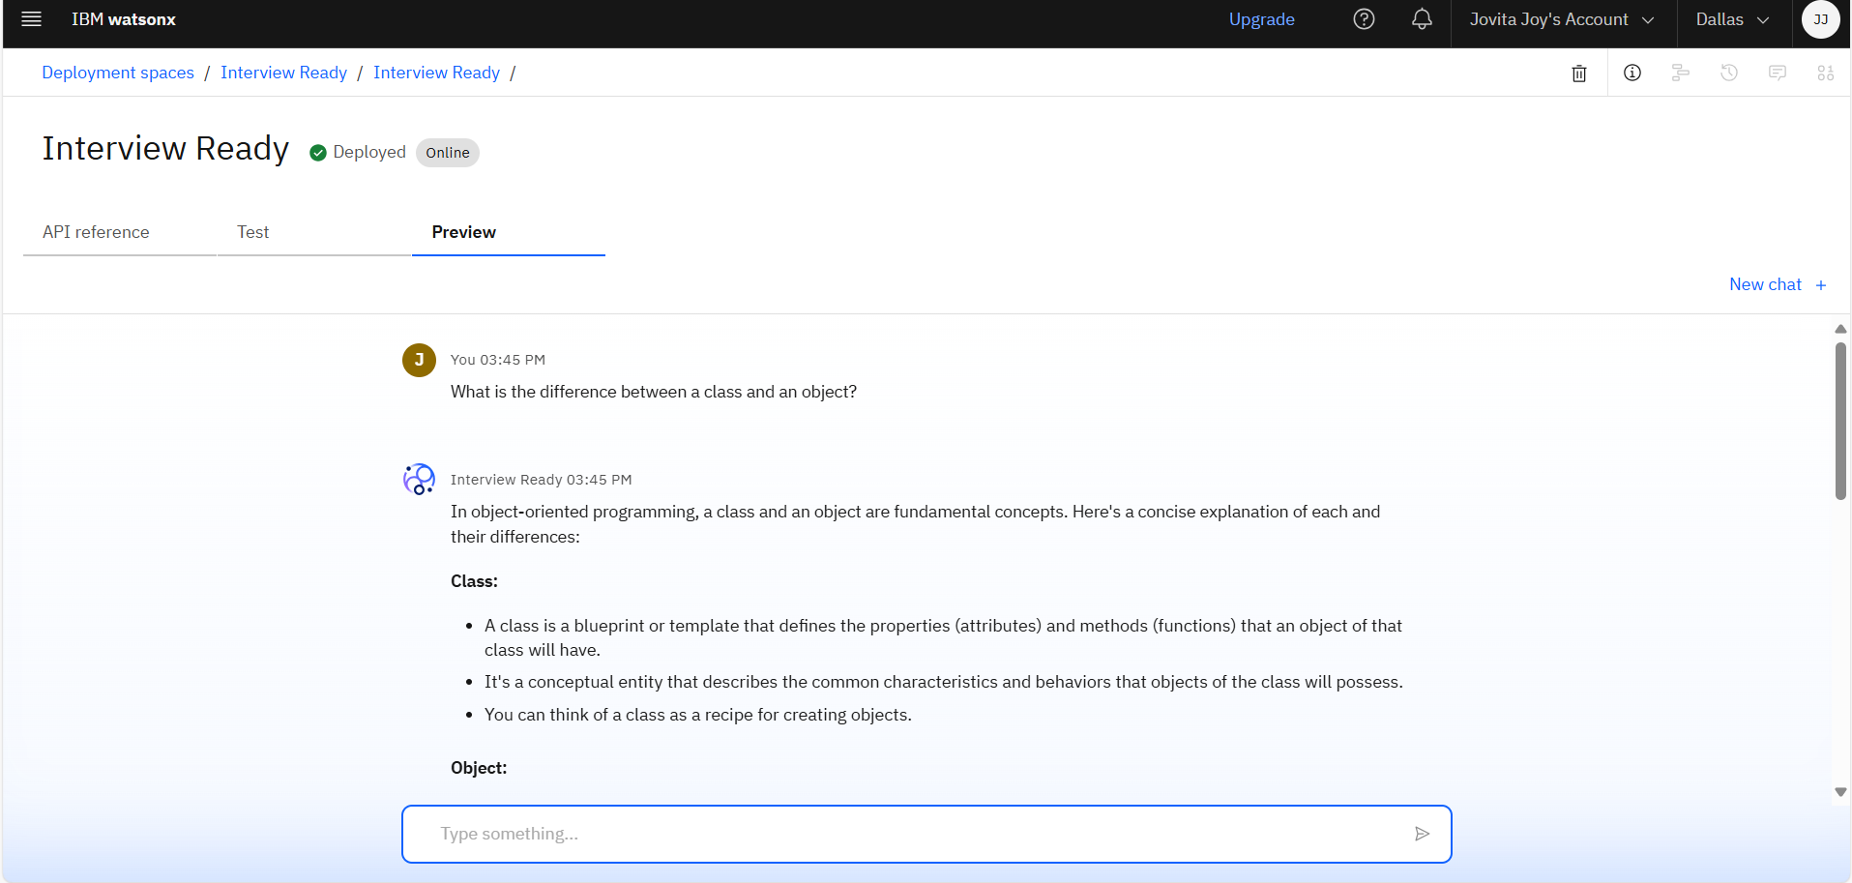
RESULTS

Slide 13
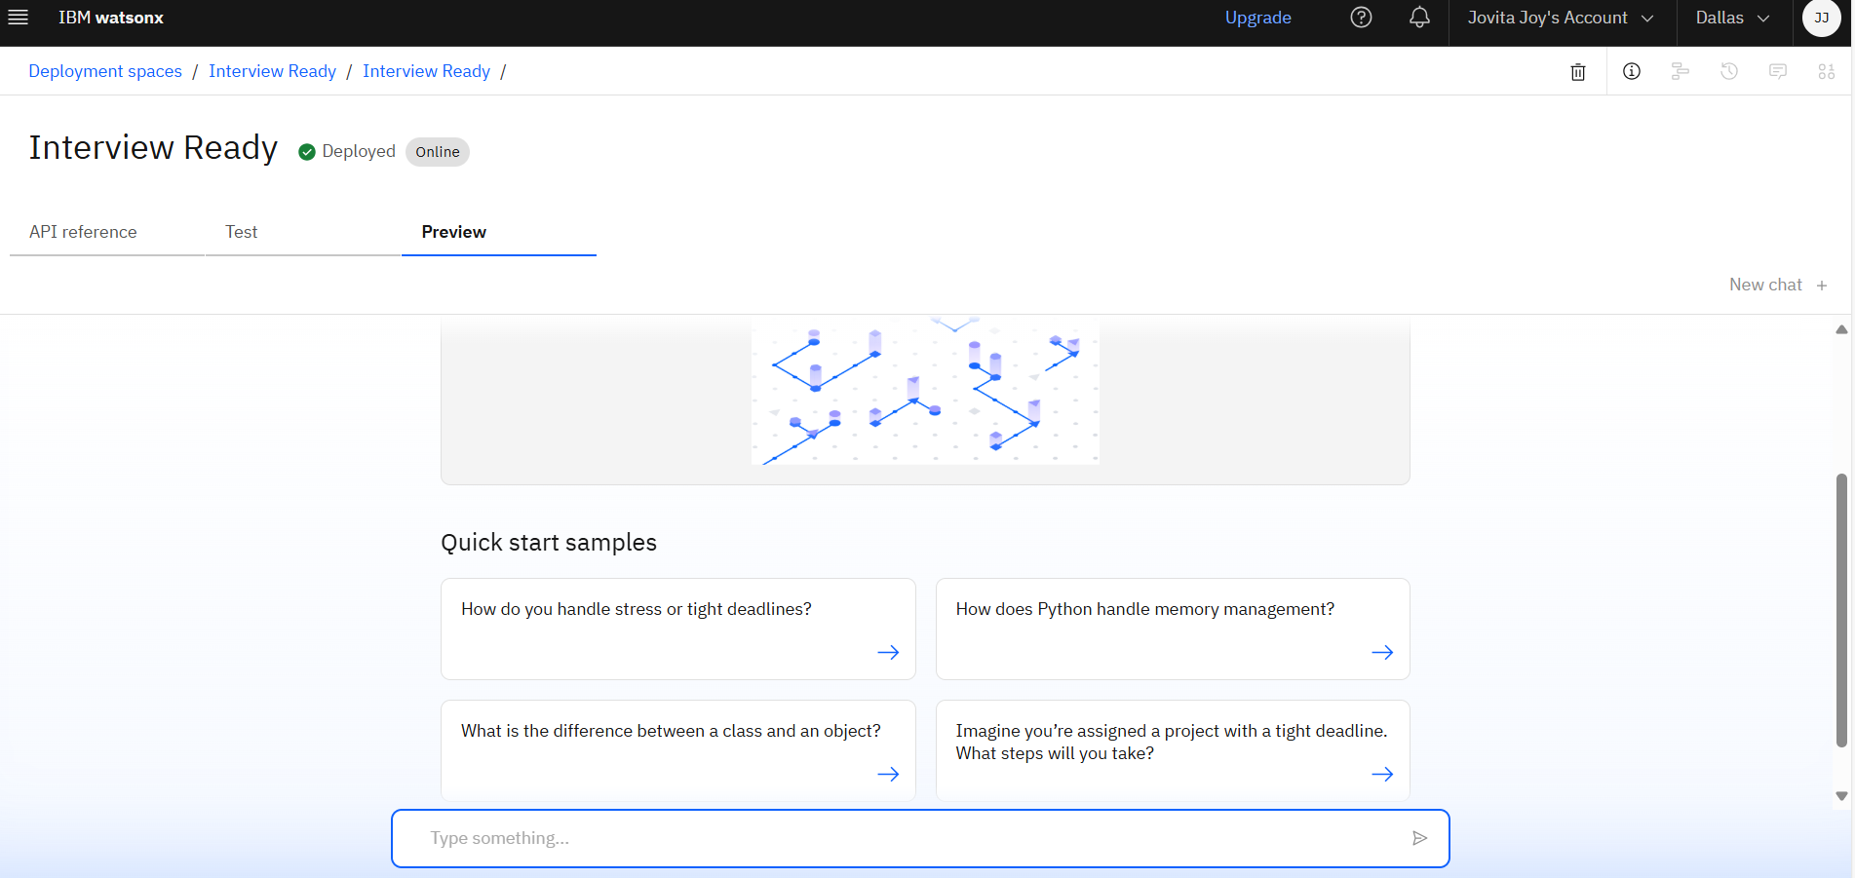
RESULTS

Slide 14
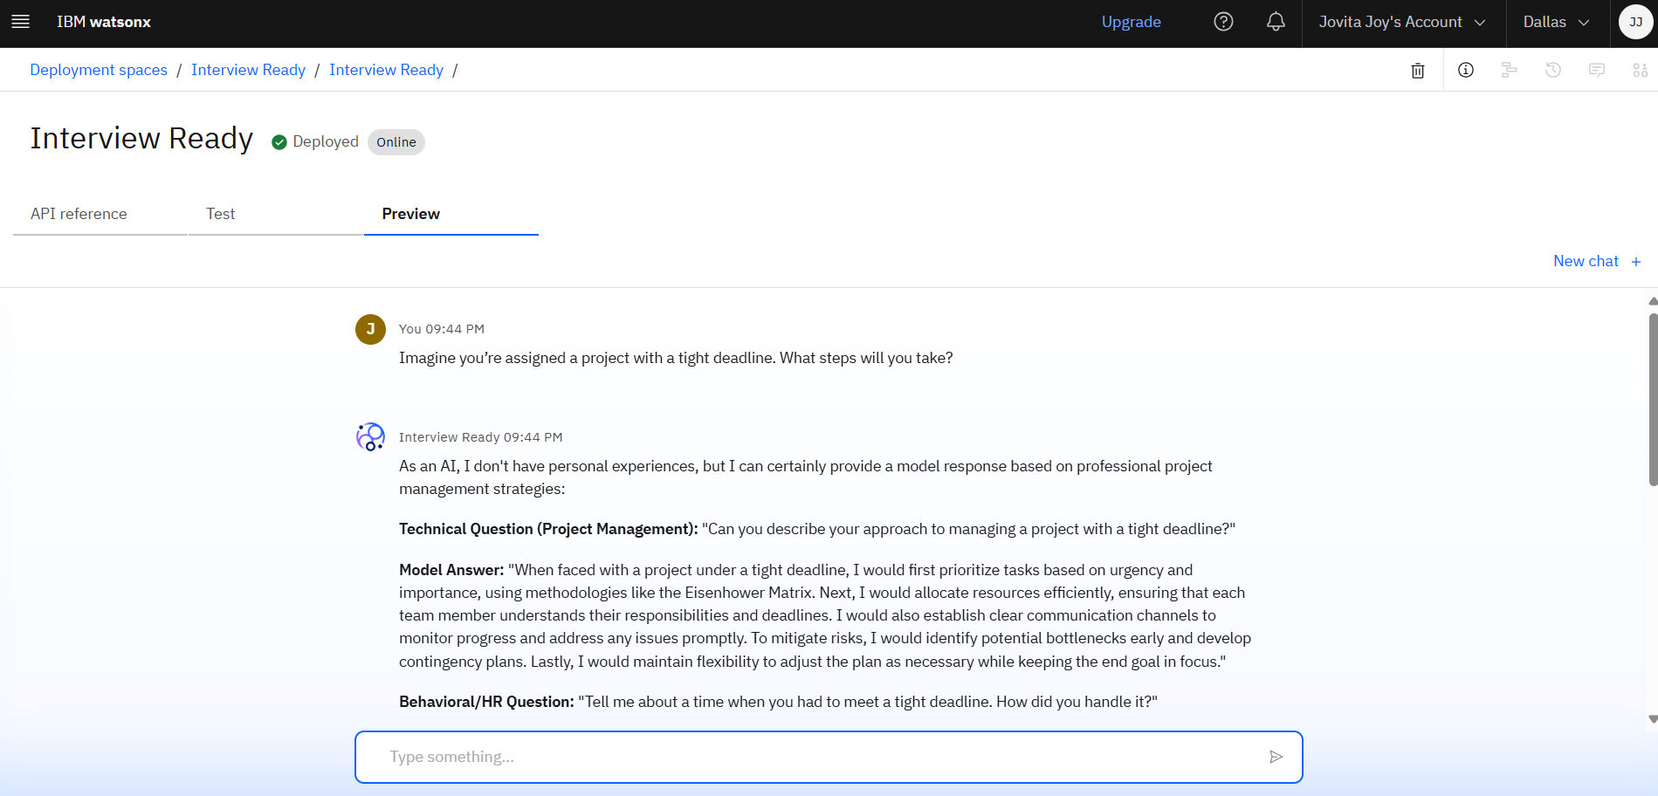
RESULTS

Slide 15
RESULTS
Deployed AI Agent

Slide 16
CONCLUSION
Interview Ready successfully demonstrates how AI can transform the job preparation experience by offering a smart, personalized, and accessible interview coaching solution. By integrating IBM Granite foundation models with Retrieval-Augmented Generation (RAG), the agent can generate dynamic, context-aware questions and high-quality model answers tailored to a user’s resume, skills, and job role.
The project reduces the dependence on expensive or generic coaching methods and empowers users—especially students and early-career professionals—to practice effectively, build confidence, and improve their chances of success in competitive job interviews.
Through seamless deployment using IBM Cloud services, Interview Ready provides a scalable, cost-effective, and interactive platform that can benefit institutions, individuals, and career development platforms alike.

Slide 17
GITHUB LINK
https://github.com/jovita-joy/Interview-Ready-Agent

Slide 18
FUTURE SCOPE
Voice-based mock interviews with speech input/output
Multilingual support for regional languages
AI scoring and feedback for user answers
Progress tracking dashboard for users
Mobile app for on-the-go practice
Integration with college placement cells
Job role suggestions based on resume and performance

Slide 19
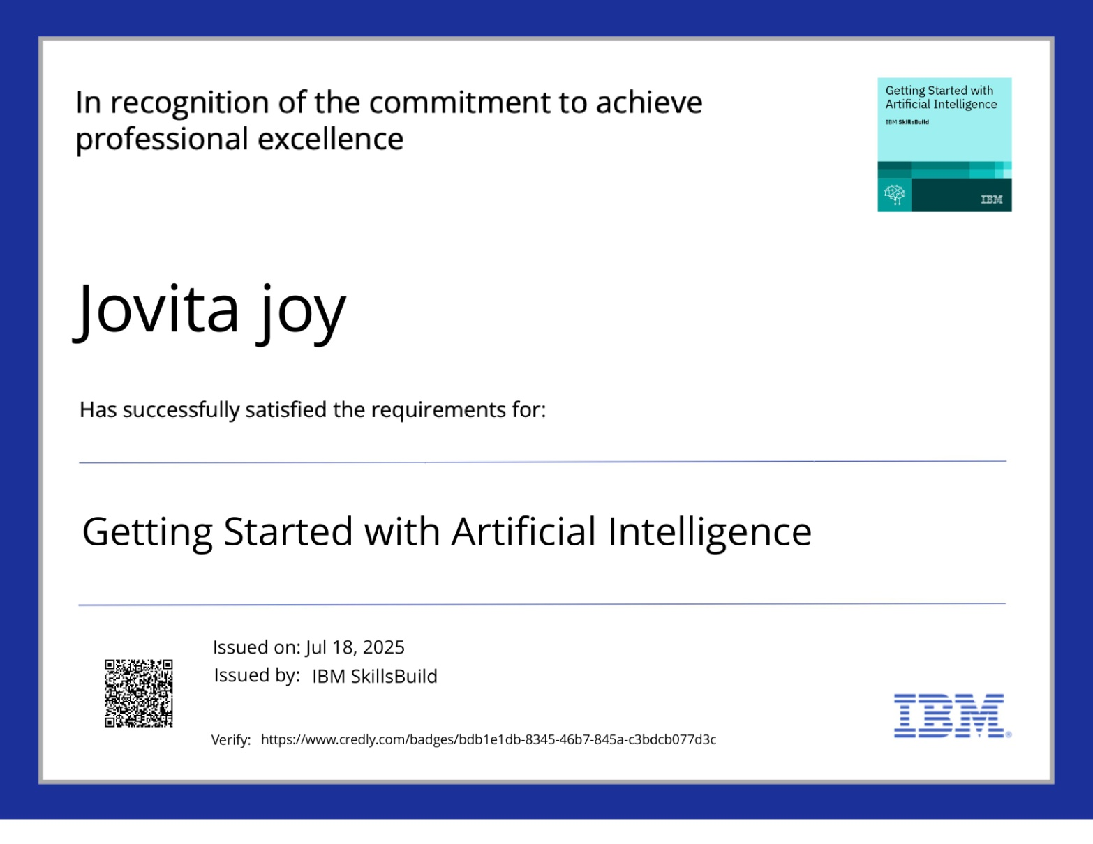
IBM CERTIFICATIONS

Slide 20
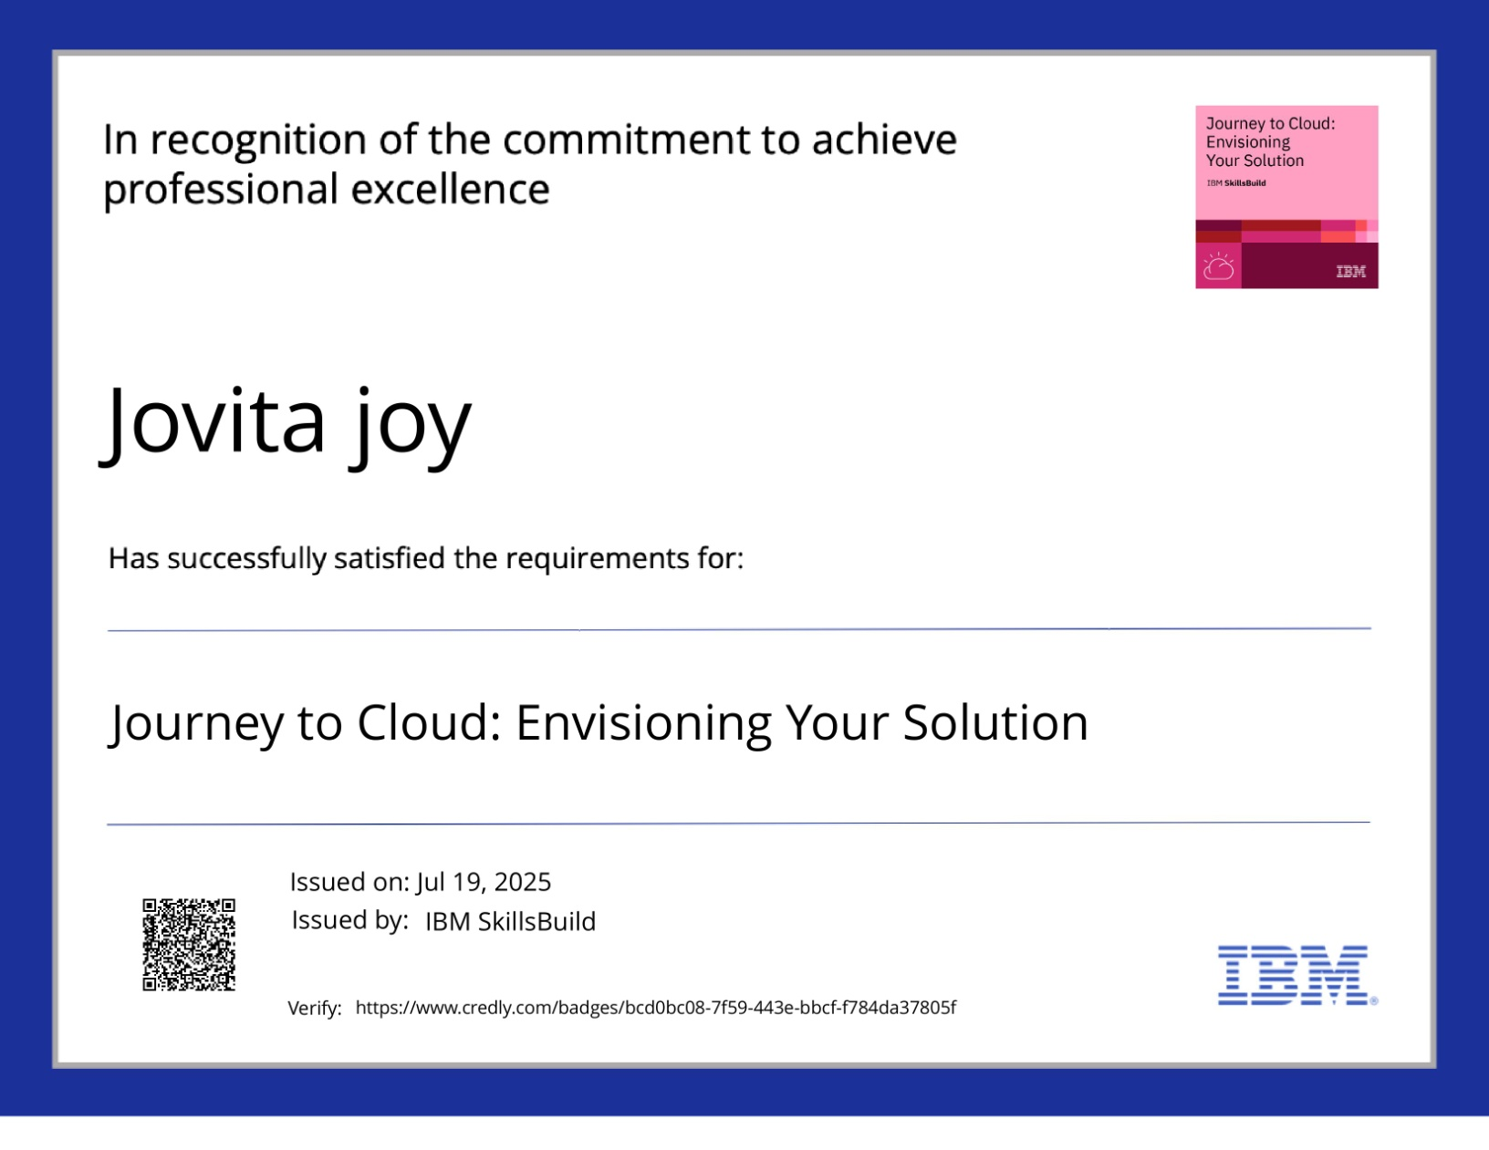
IBM CERTIFICATIONS

Slide 21
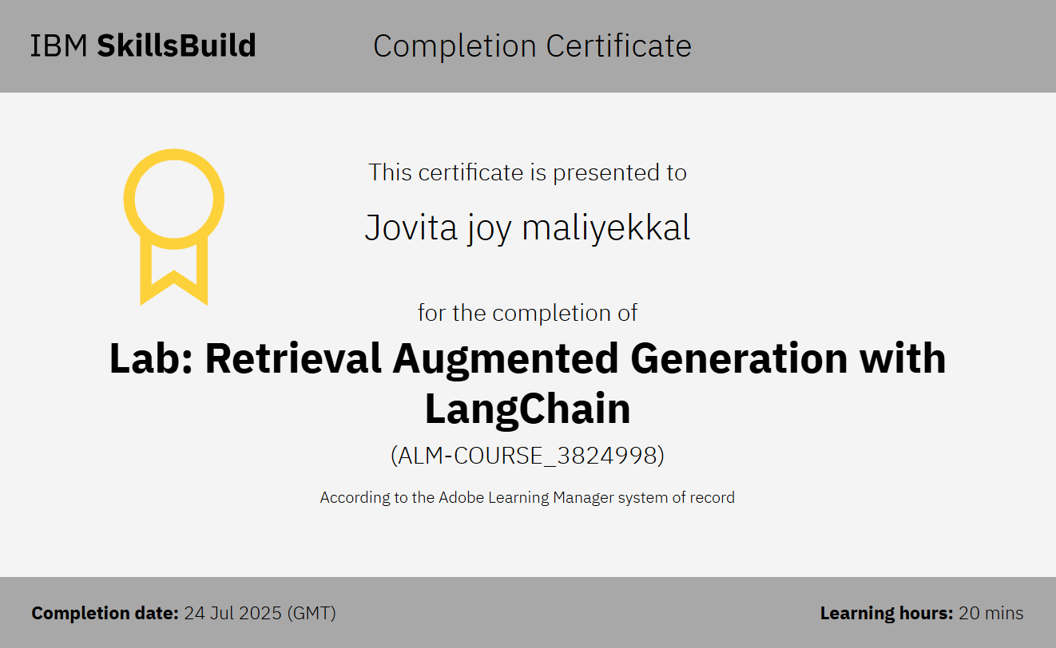
IBM LAB CERTIFICATE

Slide 22
THANK YOU

